Slide 1
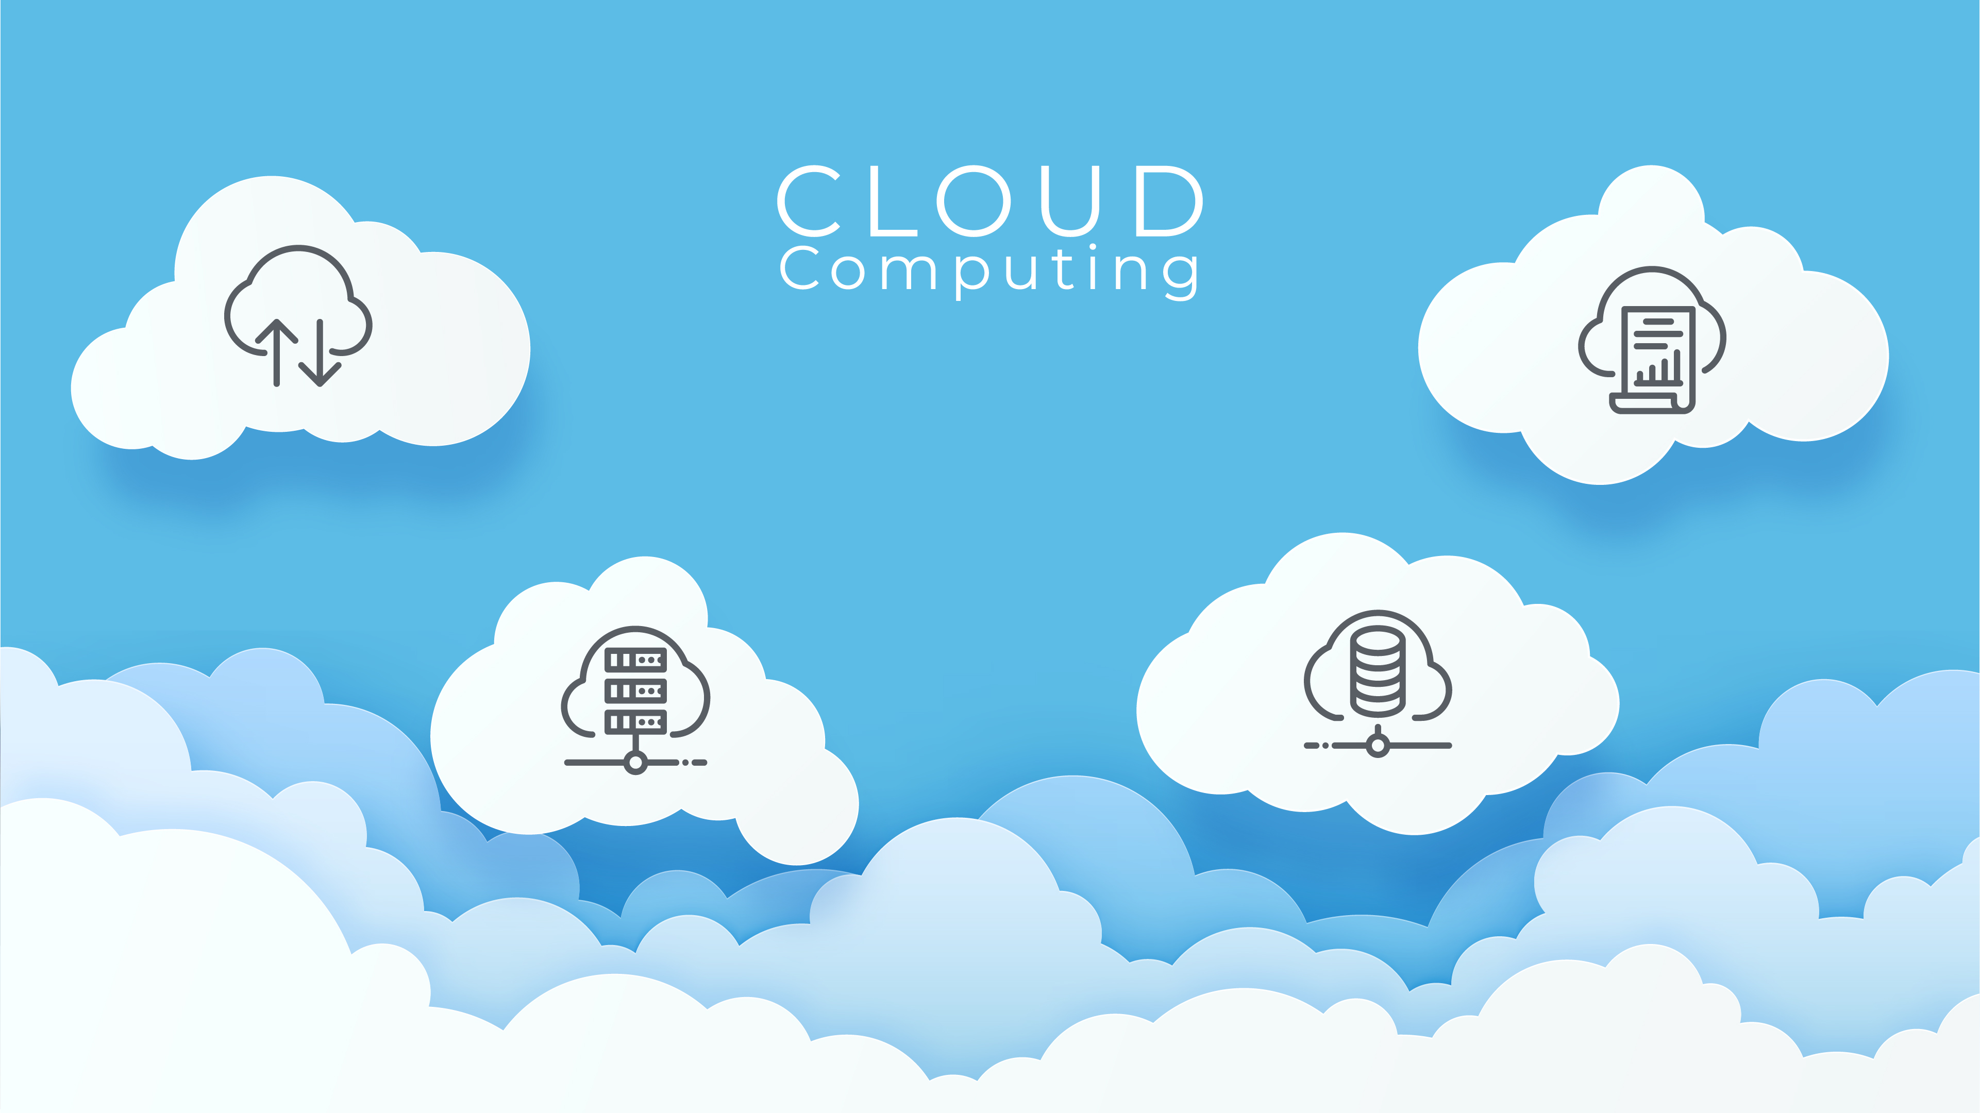
What is
Cloud computing is like renting powerful computers, storage, and tools over the internet instead of owning and maintaining them yourself. It lets people and businesses store data, run apps, and access services from anywhere with an internet connection.
Think of it as using a bank: instead of keeping your money at home, you store it securely at the bank and access it when needed.

Slide 2
Types of
Cloud Computing
Need Of Cloud Computing
Public Cloud
Definition: Shared services open for public use; anyone can subscribe and access.
Analogy: Like renting a co-working space where multiple companies share the facilities.
Example: Gmail, YouTube, or Microsoft OneDrive use public cloud technology.
Where It’s Used: Hosting websites, streaming videos, and online gaming.
Real Life Example: Netflix uses Amazon Web Services (AWS) to store and stream movies to millions of users worldwide.
Private Cloud
Definition: Dedicated services for a single organization with more security and control.
Analogy: Like owning a private office for your business.
Example: Banks and hospitals use private clouds to secure sensitive data like customer accounts and medical records.
Where It’s Used: Healthcare systems and financial institutions.
Real Life Example: A hospital uses its private cloud to store patient data securely while enabling remote access for doctors.
Hybrid Cloud
Definition: A mix of public and private clouds; sensitive data stays private, while less-critical tasks use the public cloud.
Analogy: Like having a private office for confidential work and using a co-working space for meetings.
Example: A company may keep employee data in a private cloud but use public clouds for marketing tools.
Real Life Example: An e-commerce company uses a private cloud for customer data but leverages AWS for running sales promotions.
Cost Savings: Cloud computing eliminates the need for buying and maintaining expensive servers.
Example: Netflix uses AWS to stream movies without investing in its own servers.
Scalability: Cloud services allow businesses to easily increase or decrease resources based on demand.
Example: When a new season of a popular show is released, Netflix can quickly scale up its cloud resources to handle more viewers.
Remote Access: Cloud computing enables employees to work from anywhere and access files on the go.
Example: Google Drive lets users access their documents from any device with an internet connection.
Data Security and Backup: Cloud services securely store data and provide automatic backup and recovery.
Example: Cloud storage platforms like Dropbox ensure files are safe and recoverable in case of data loss.
Faster Innovation: Cloud platforms offer tools for rapid app development, AI, and big data analytics.
Example: Developers use Google Cloud to build and launch apps faster without worrying about infrastructure.
Environmental Sustainability: Cloud data centers are more energy-efficient and reduce the environmental impact compared to on-site data storage.
Example: Companies like Google use renewable energy to power their cloud servers.
6.
5.
7.
4.
3.
1.
2.

Slide 3
Need Of Cloud Computing
Types of Cloud Computing
Public Cloud
Definition: Shared services open for public use; anyone can subscribe and access.
Analogy: Like renting a co-working space where multiple companies share the facilities.
Example: Gmail, YouTube, or Microsoft OneDrive use public cloud technology.
Where It’s Used: Hosting websites, streaming videos, and online gaming.
Real Life Example: Netflix uses Amazon Web Services (AWS) to store and stream movies to millions of users worldwide.
Private Cloud
Definition: Dedicated services for a single organization with more security and control.
Analogy: Like owning a private office for your business.
Example: Banks and hospitals use private clouds to secure sensitive data like customer accounts and medical records.
Where It’s Used: Healthcare systems and financial institutions.
Real Life Example: A hospital uses its private cloud to store patient data securely while enabling remote access for doctors.
Hybrid Cloud
Definition: A mix of public and private clouds; sensitive data stays private, while less-critical tasks use the public cloud.
Analogy: Like having a private office for confidential work and using a co-working space for meetings.
Example: A company may keep employee data in a private cloud but use public clouds for marketing tools.
Real Life Example: An e-commerce company uses a private cloud for customer data but leverages AWS for running sales promotions.
Cost Savings: Cloud computing eliminates the need for buying and maintaining expensive servers.
Example: Netflix uses AWS to stream movies without investing in its own servers.
Scalability: Cloud services allow businesses to easily increase or decrease resources based on demand.
Example: When a new season of a popular show is released, Netflix can quickly scale up its cloud resources to handle more viewers.
Remote Access: Cloud computing enables employees to work from anywhere and access files on the go.
Example: Google Drive lets users access their documents from any device with an internet connection.
Data Security and Backup: Cloud services securely store data and provide automatic backup and recovery.
Example: Cloud storage platforms like Dropbox ensure files are safe and recoverable in case of data loss.
Faster Innovation: Cloud platforms offer tools for rapid app development, AI, and big data analytics.
Example: Developers use Google Cloud to build and launch apps faster without worrying about infrastructure.
Environmental Sustainability: Cloud data centers are more energy-efficient and reduce the environmental impact compared to on-site data storage.
Example: Companies like Google use renewable energy to power their cloud servers.
6.
5.
7.
4.
3.
1.
2.

Slide 4
Cloud Service Models
Infrastructure as a Service (IaaS)
Definition: Provides virtual computers and servers for users to customize and use.
Analogy: Like renting a blank apartment where you bring your furniture and set it up the way you like.
Example: AWS EC2 (Elastic Compute Cloud) or Microsoft Azure Virtual Machines.
Real Life Example: A startup builds its website on AWS without buying its own physical servers.
Platform as a Service (PaaS)
Definition: Offers pre-built tools and environments for developers to create and deploy applications.
Analogy: Like renting a furnished apartment where you can focus on living without worrying about setup.
Example: Google App Engine or Microsoft Azure App Service.
Real Life Example: A developer uses Heroku to build and host an app without worrying about server configurations.
Software as a Service (SaaS)
Definition: Ready-to-use software applications delivered online.
Analogy: Like subscribing to a streaming service where everything is ready; you just enjoy the content.
Example: Google Docs, Dropbox, and Zoom.
Real Life Example: A student uses Google Docs to write assignments and save them automatically in the cloud.
6.
5.
7.
4.
1.
3.
2.

Slide 5
Real-Life Applications of Cloud Computing
Storing Photos and Files
Example: Google Drive lets you save photos, documents, and videos in the cloud so you can access them from your phone, laptop, or tablet.
Online Classes
Example: Teachers use Google Classroom to share lessons, and students submit assignments, all through the cloud.
Streaming Movies
Example: Netflix stores and streams videos using AWS, ensuring millions can watch without buffering.
Playing Games
Example: Google Stadia lets gamers play high-quality games without owning a gaming console. The cloud handles all the processing.
Shopping Online
Example: Amazon uses its cloud platform to manage millions of users and orders simultaneously.
Weather Forecasting
Example: Meteorologists use cloud computing to process huge amounts of weather data and deliver forecasts.
6.
7.
5.
3.
1.
2.
4.

Slide 6
Benefits of Cloud Computing with Analogies
Cost-Effective
Analogy: Renting a car instead of buying one; you only pay for what you use.
Example: A startup uses cloud servers to save money instead of buying expensive hardware.
Accessible Anywhere
Analogy: Like using online banking—you can access your account from any device.
Example: A student accesses lecture slides saved on Dropbox from their phone.
Scalable
Analogy: Like adding extra seats at a party when more guests arrive.
Example: An online store increases its server capacity during a big sale.
Backup and Recovery
Analogy: Like keeping photocopies of important documents in case you lose the originals.
Example: A business stores its data on the cloud to recover quickly after a natural disaster.
Collaboration
Analogy: Like sharing a group chat where everyone can contribute ideas in real time.
Example: Teams work together on projects using tools like Microsoft Teams or Slack.
6.
7.
1.
5.
4.
2.
3.

Slide 7
Challenges of Cloud Computing
Internet Dependency
Example: Without the internet, users can’t access cloud services like Netflix or Google Drive.
Privacy Concerns
Example: Companies worry about storing sensitive customer data in the cloud without proper encryption.
Costs Can Add Up
Example: A small business may face higher bills if it overuses cloud services during peak times.
Data Regulations
Example: A company operating in Europe must comply with GDPR laws when storing customer data on the cloud.
7.
4.
1.
6.
2.
3.
5.

Slide 8
Future of Cloud Computing
Serverless Computing
Developers focus on writing code, and the cloud handles everything else.
Example: AWS Lambda enables developers to run functions without managing servers.
Edge Computing
Data is processed closer to its source (e.g., on a smart device), reducing delays.
Example: Smart home devices like Amazon Alexa use edge computing for faster responses.
AI in the Cloud
Cloud platforms provide AI tools for tasks like language translation or fraud detection.
Example: Google Cloud AI powers voice recognition in apps like Google Assistant.
Quantum Computing
Quantum computing in the cloud will solve complex problems in seconds.
Example: IBM is exploring quantum computing to optimize logistics and healthcare research.
2.
1.
3.
7.
4.
5.
6.

Slide 9
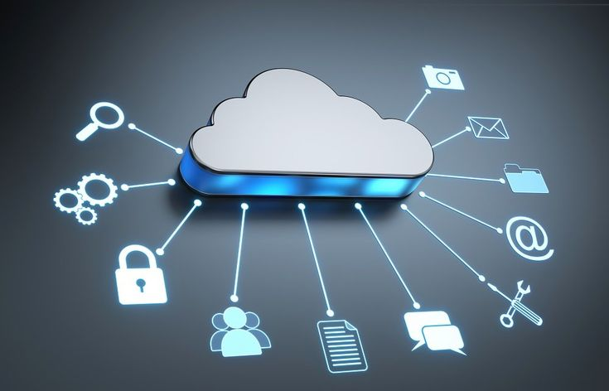
Thank you

